Slide 1

THEME : SMART WATER FOUNDATION
PROJECT BY:
M.VEDHALAKSHMI
S.SOWMYA
J.REKHA
R.MONISHA
A.SARANYA

Slide 2

Agenda
Introduction
Objective
IOT Sensor System
Mobile App
Tools
Conclusion

Slide 3
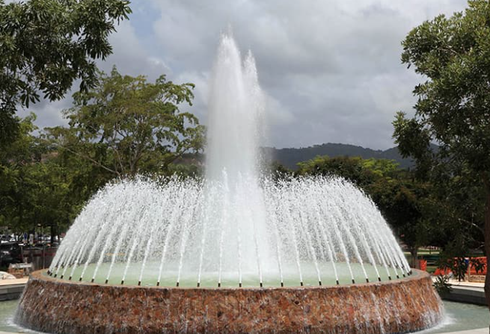
Introduction
At Smart water fountain is a device or structure that sends a stream of water in to the air in a garden, Park, companies, etc,..

Slide 4
Objective
One water fountain with intelligent monitoring system based on the internet of things is discussed in this paper.
The key parameters of the water fountain were derived from the sensors and transmitted the encrypted data by GPRS or WIFI net to central server automatically.
The Access database was established according to the real time running data of each water fountain fixed everywhere. The unified database management and maintenance could be achieved with the PC interface application by the users or the server station administrator with different authority.

Slide 5
IOT Sensor System
A hybrid application and two devices make up the microgrid system. The first device measures the water tank’s height and sends the real-time information to the cloud using a smart-level device.
The GSM module of the smart level sends a signal to another device, a motor-controlled device, which automatically activates and deactivates the motor based on the signal. They activate and deactivate motors when they receive an input signal. With this technology, a leakage measurement hybrid application has been constructed.
The device’s ultrasonic Smart Level sensor continuously monitors the tank’s height and uploads that data to the internet once per minute.

Slide 6
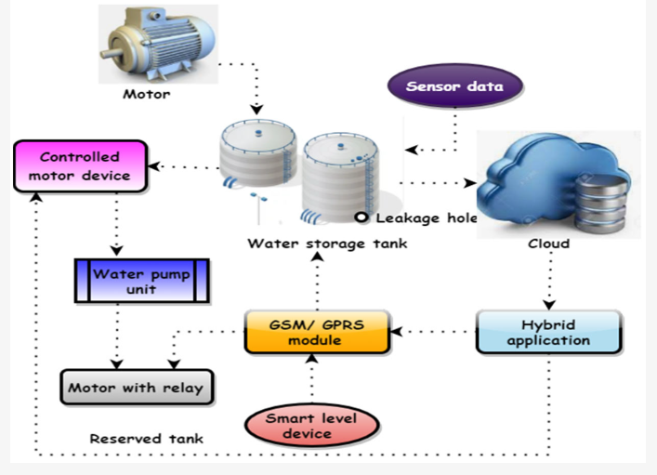
IOT Sensor System
As the water level in the tank rises or falls, the intelligent level device sends a signal to the regulated motor device to turn the motor on or off, respectively
IoT devices upload information to the cloud, which can be evaluated later. Users can tell the system to alert them if a specific threshold is met. A system for intelligent water management should allow for constant monitoring of water levels.

Slide 7
Tools
IOT Technology
Phython
Mobile App
Paired with the Mi Home/Xiaomi Home app, it can push reminders to your phone when it is necessary to add water, clean the fountain and replace the filter.

Slide 8
Conclusion
IOT sensor, embedded in the IOT solutions, ease the water quality monitoring. Embedded with multiple sensors that measure most of the water quality parameters, IOT Water is the most trusted water quality sensing solutions which gets connected to the cloud for real-time monitoring

Slide 9

Thank you

